Slide 1

Datathon
OATH Hearings Division Case Status
By: Conner, Alex, Jovani and Saliou

Slide 2
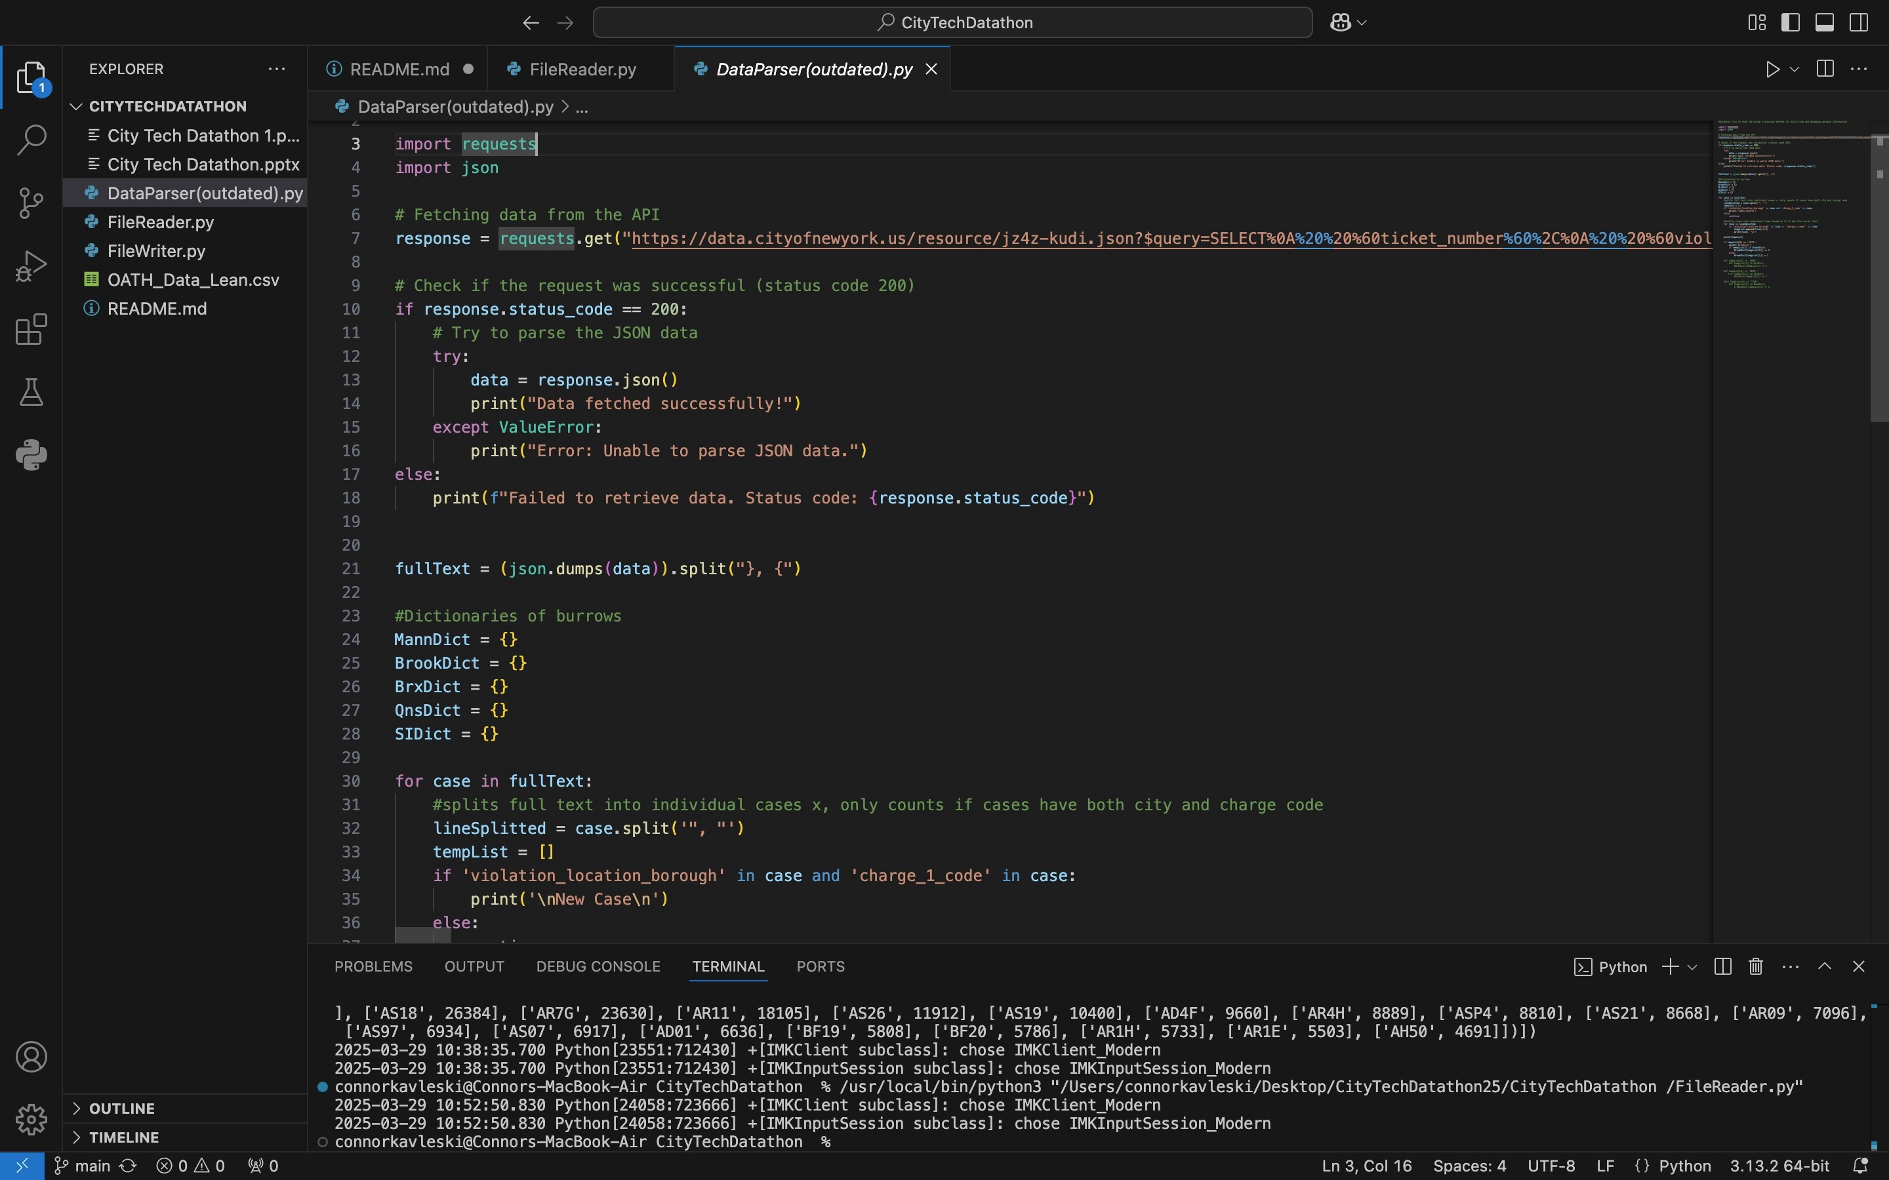

Slide 3
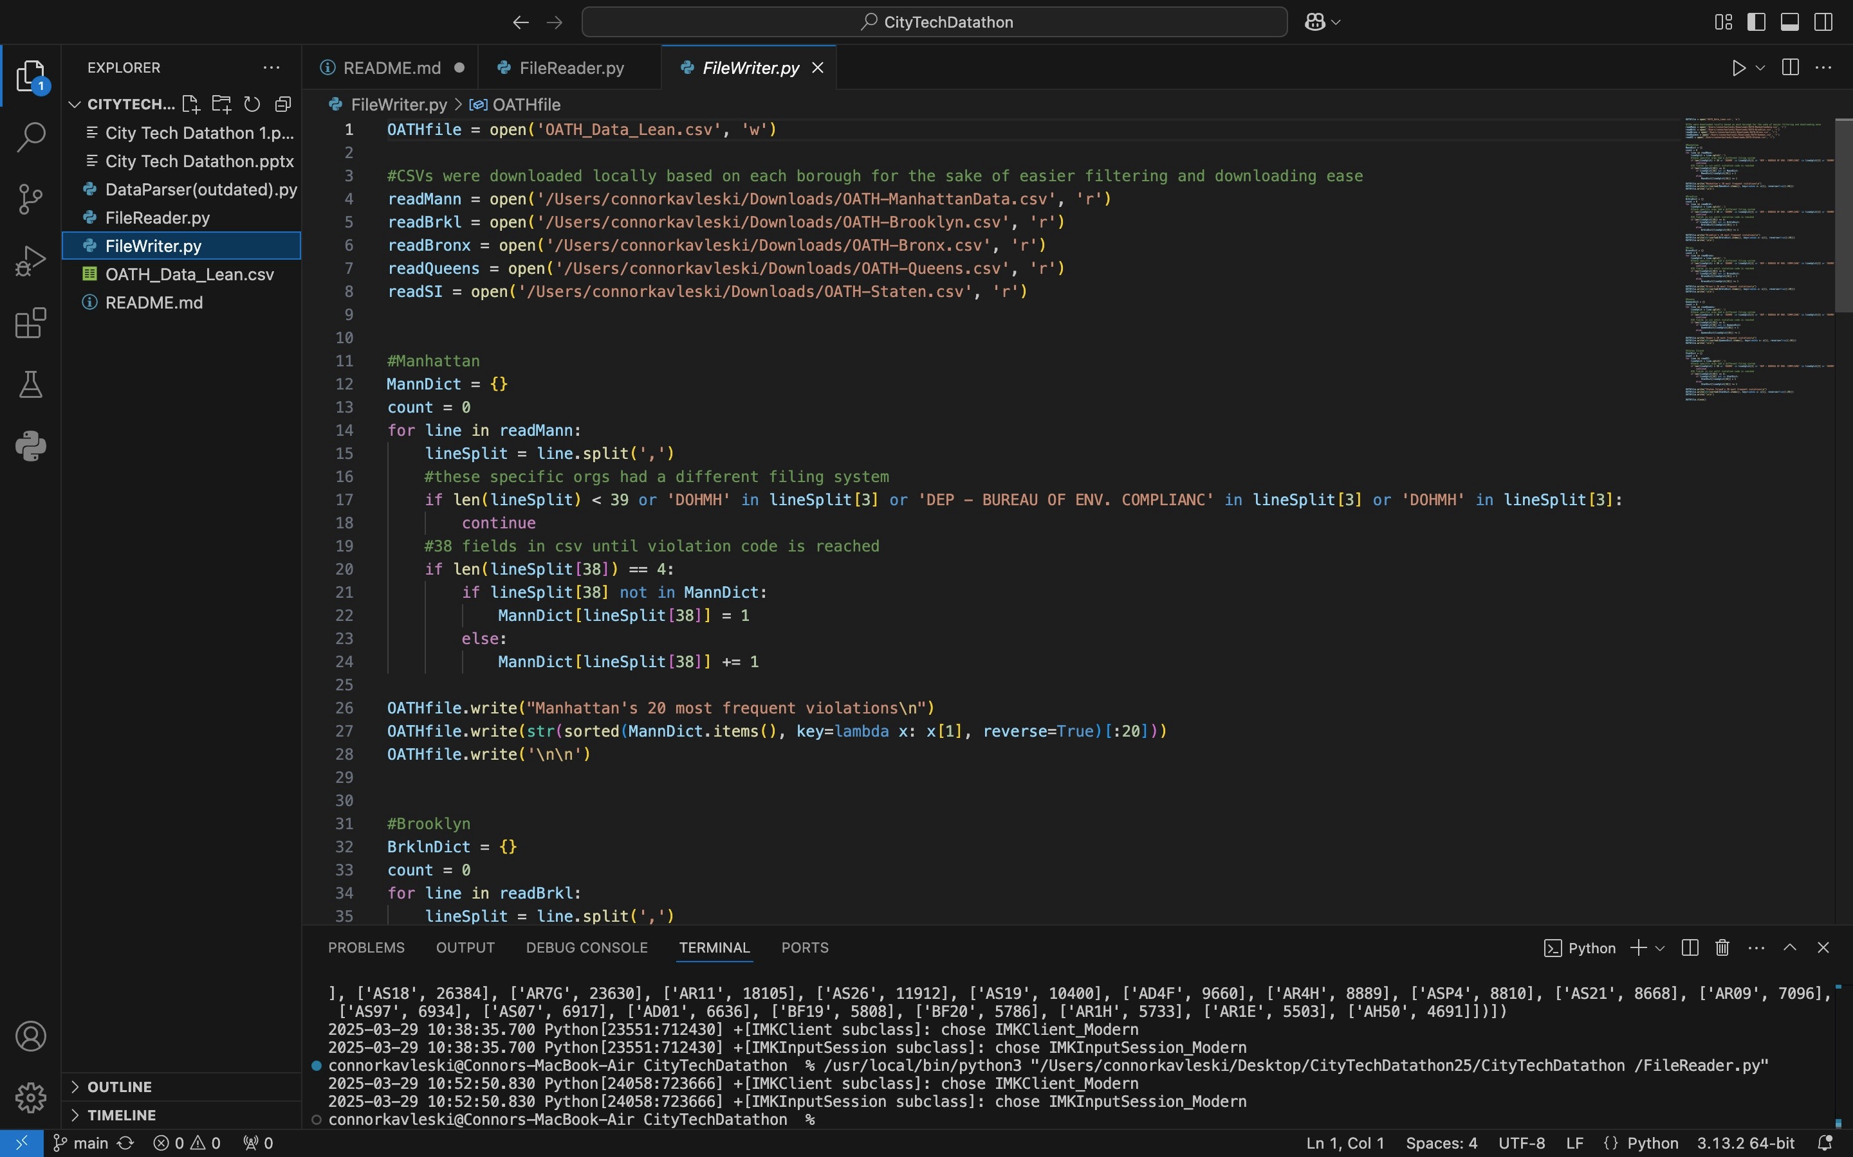

Slide 4
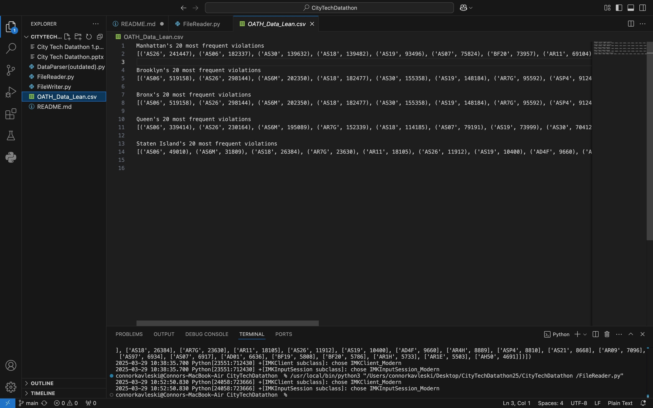

Slide 5
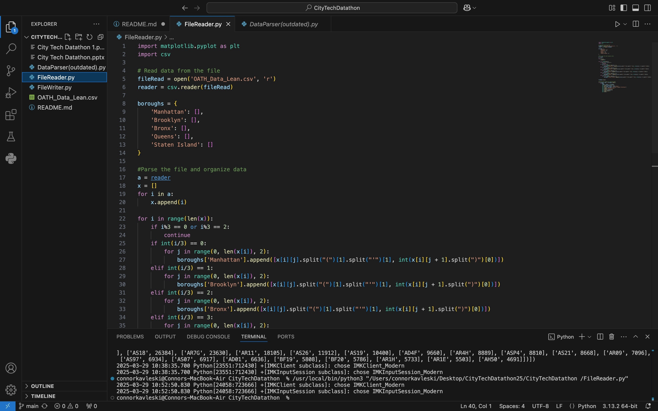

Slide 6
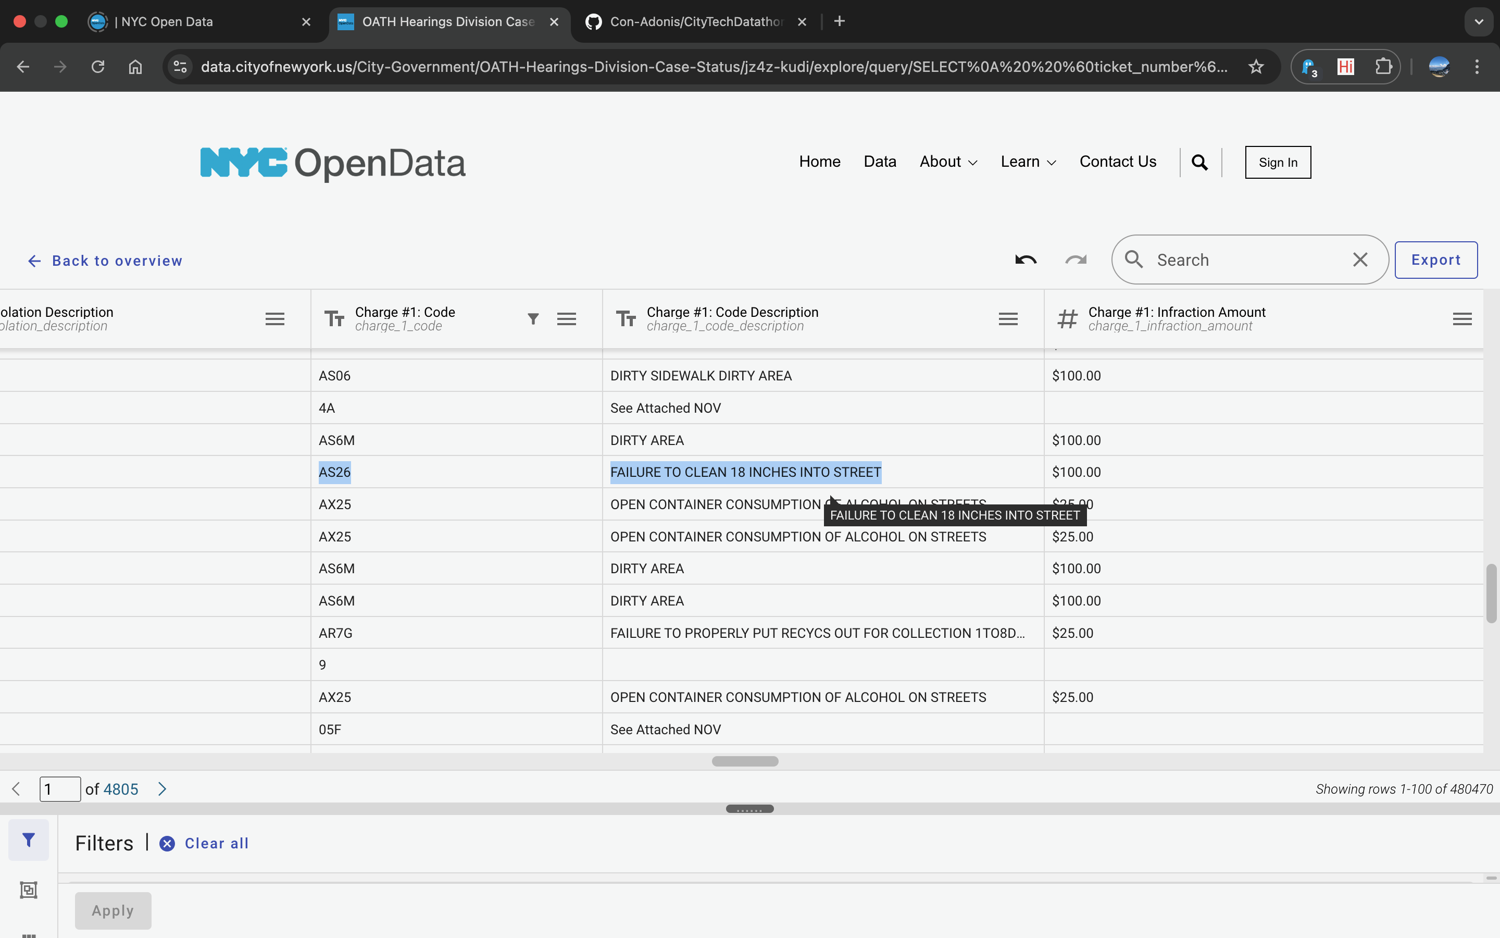

Slide 7
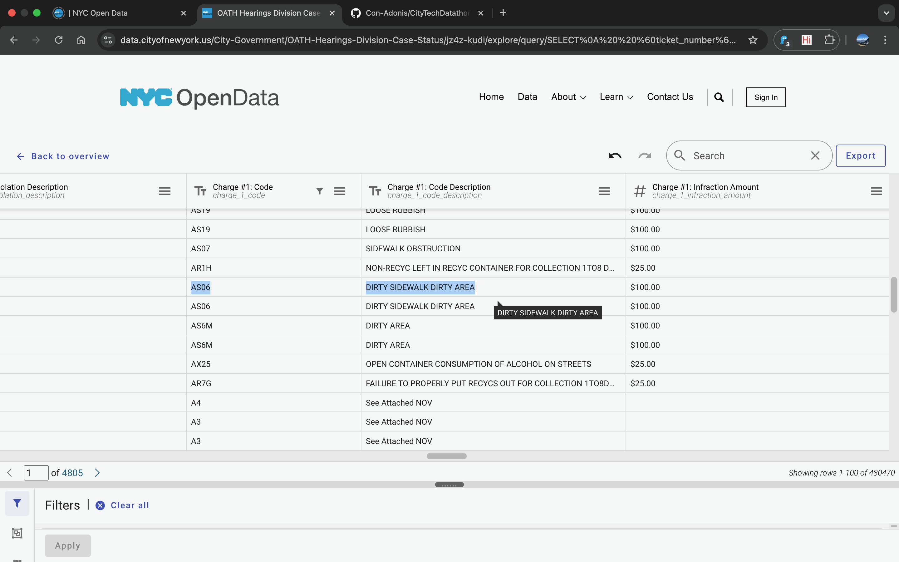

Slide 8

Over the span of roughly 8 years this dataset has been collecting violation issues, 2,688,888 breaching's of codes AS26 and AS06 have been done
This costs NYC businesses a total of $268,888,800 since the dataset has been created, as these violations both incur $100 fines by simply not having the sidewalk/ street in front of their stores standardly cleaned.

Slide 9
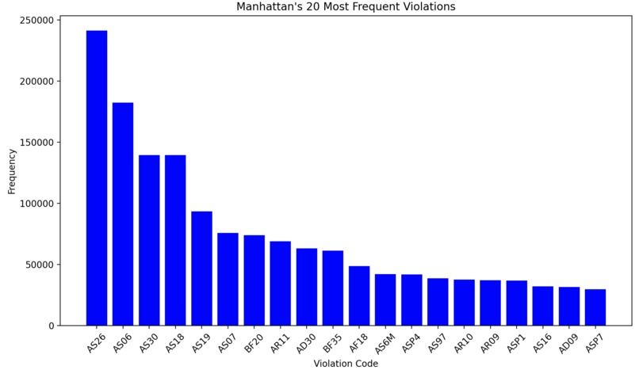

Slide 13
